Slide 1
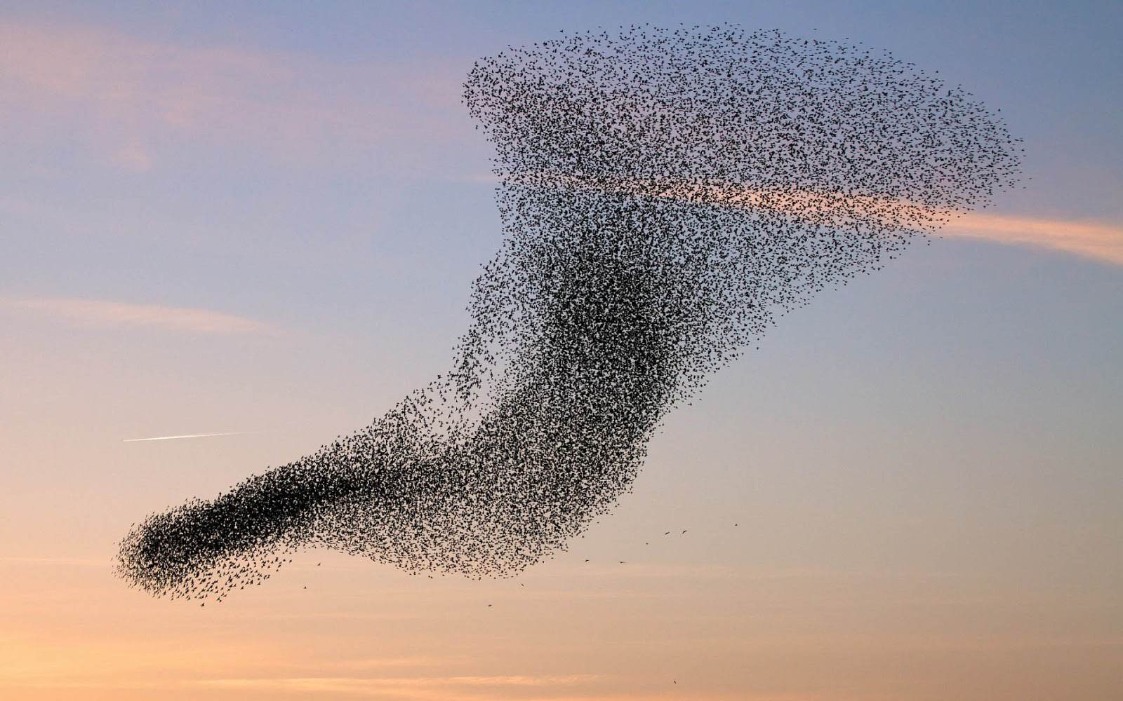
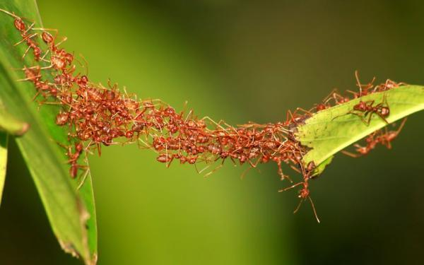
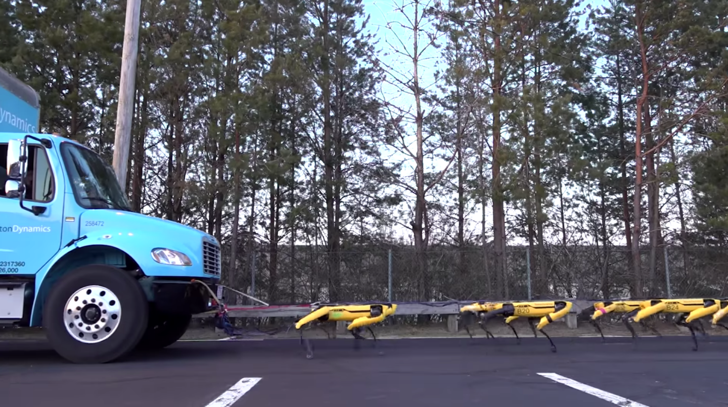
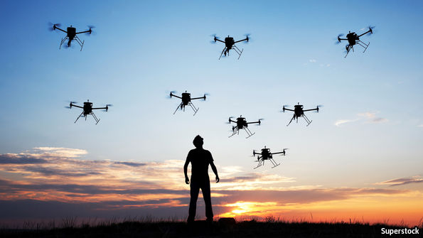



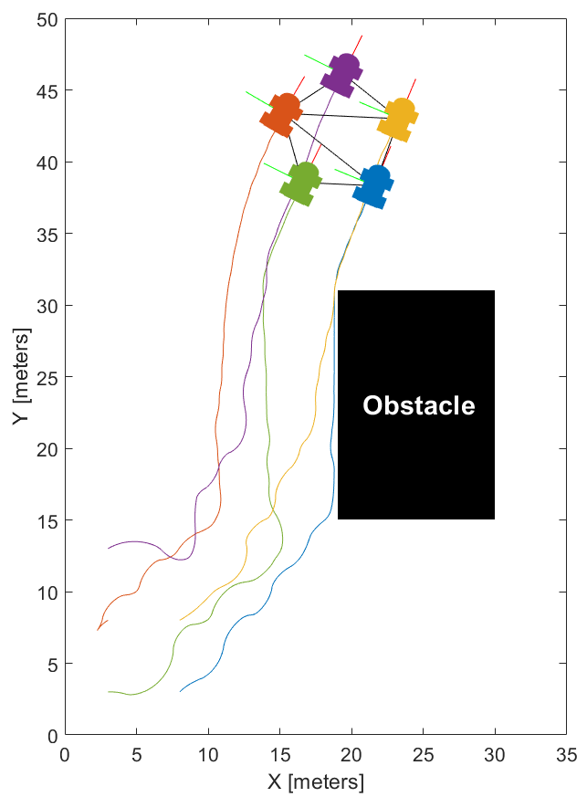
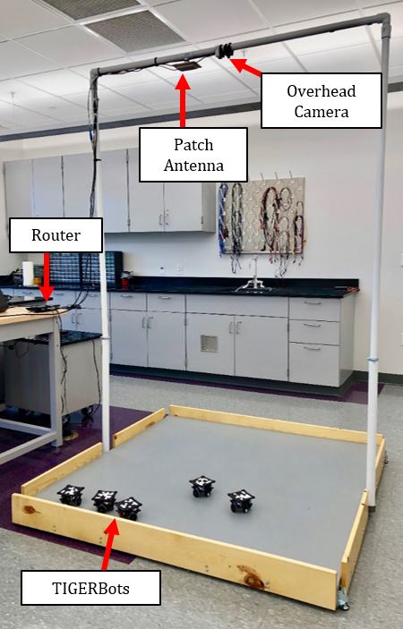
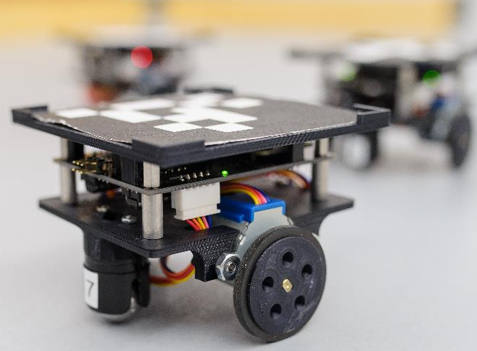
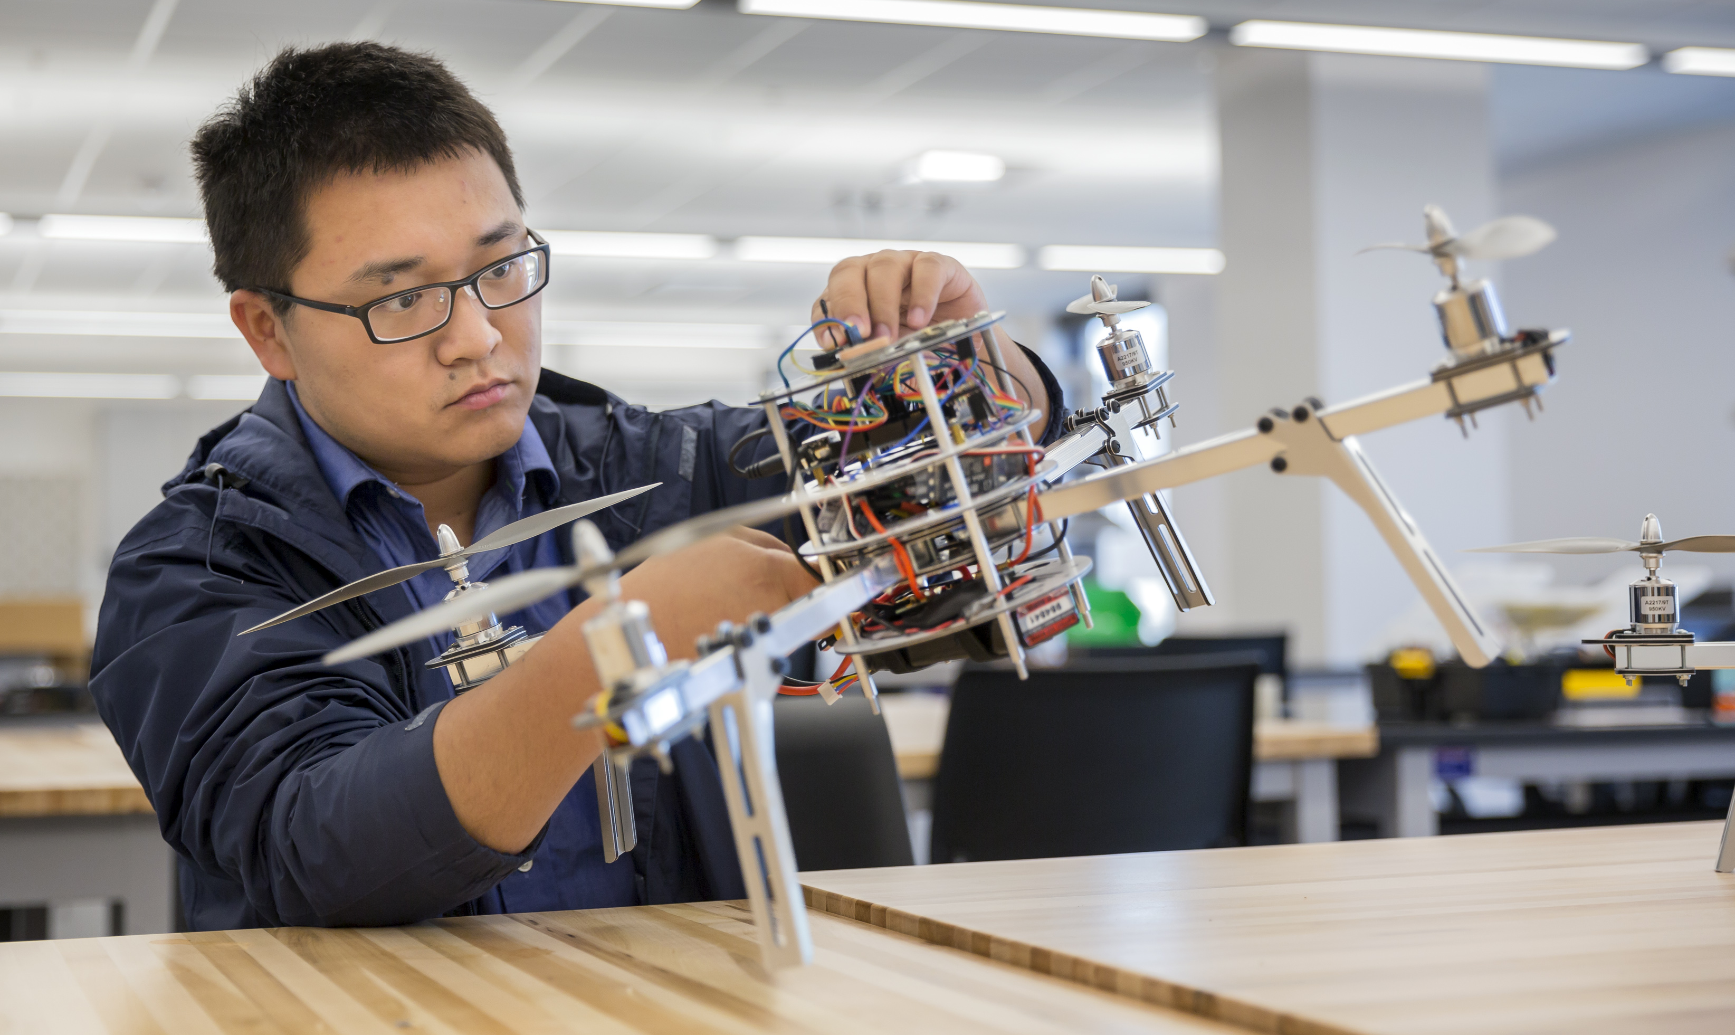


Decentralized Formation Control of Teams of Autonomous Agents
Motivation
Nature
Engineered Systems
Inspiration
Air traffic management
Search and rescue
Area coverage
Perimeter protection
Co-transportation of large objects
Autonomy Modes
Centralized
Our Research
1
Tools
Rigid graph theory
Nonlinear systems theory
Distance-based control
Applications
Formation maneuvering
Target interception
Splitting and merging
Outcomes
Switched autonomy
Stability guarantees
Collision/obstacle avoidance
2
Agents
Localization (L)
4
3
Communication (C)
Processing (P)
Experimentation
Unified L/C/P
Critical points-of-failure
Decentralized
Computer Simulation
1
2
4
3
Distributed, onboard L/C/P
Robust and versatile (e.g., GPS-denied environments)
Innovation in Control and
Robotics Engineering Lab
Dr. Marcio de Queiroz

